Slide 1
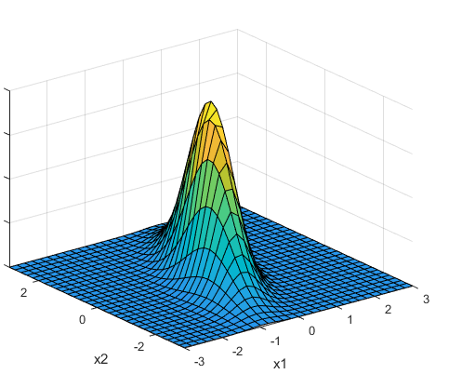
A primer on Bayesian statistics for introductory statistical machine learning Christopher A. Penfold Gurdon Lab Wellcome/CRUK Gurdon Institute

Slide 2


Slide 3
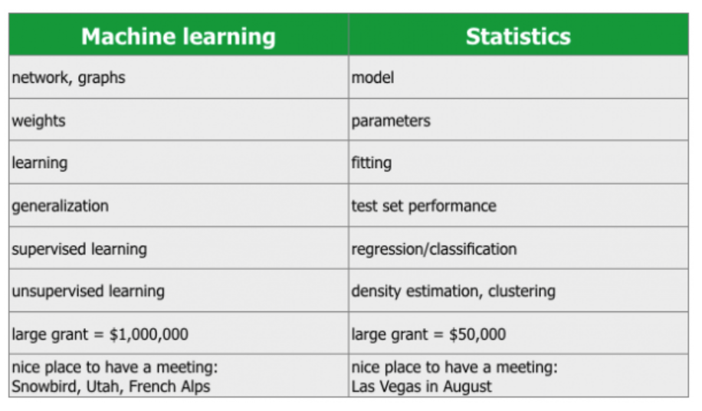

X
https://www.r-bloggers.com/whats-the-difference-between-machine-learning-statistics-and-data-mining/
Statistics and machine learning are fundamentally different. Statistics aims to provide a human with the tools to analyze data. Machine learning wants to replace the human in the processing of data.
Neil Lawrence (http://inverseprobability.com)

Slide 4
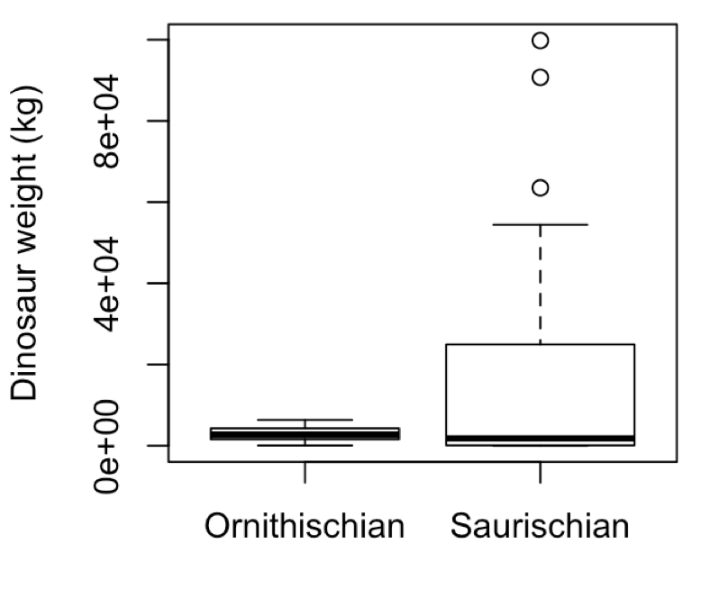
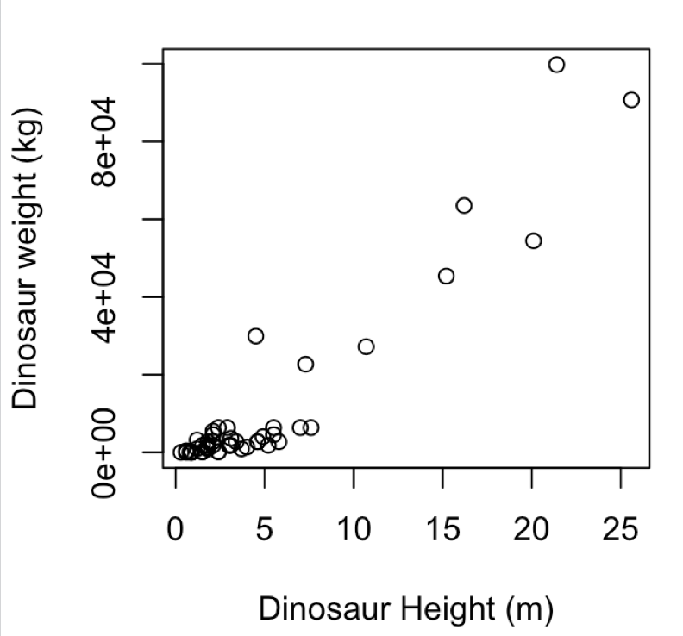
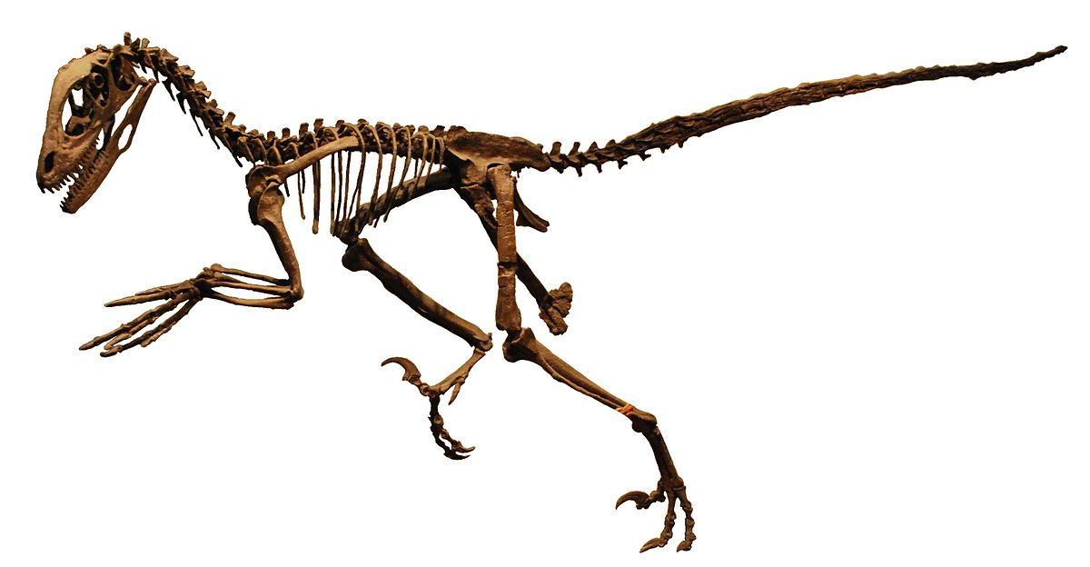
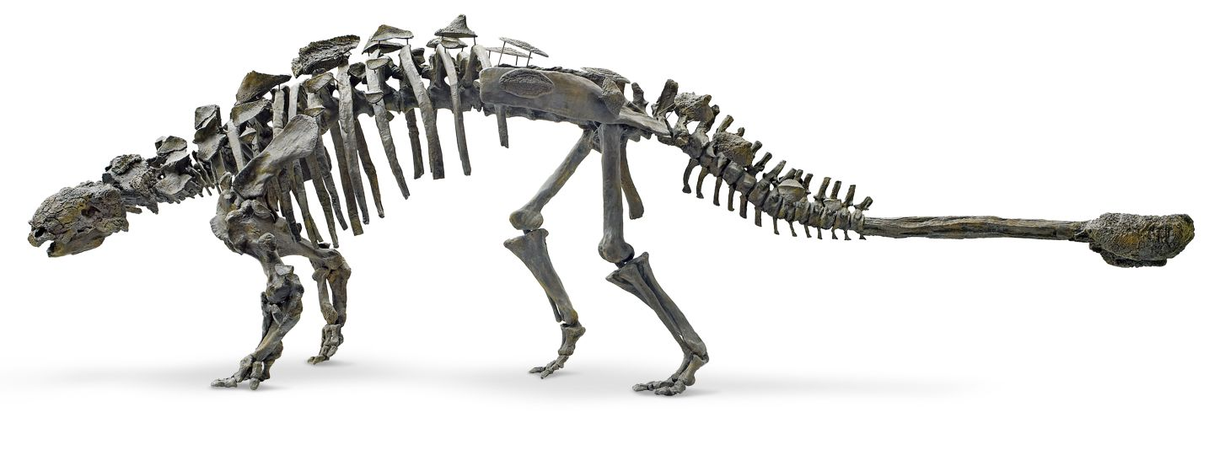
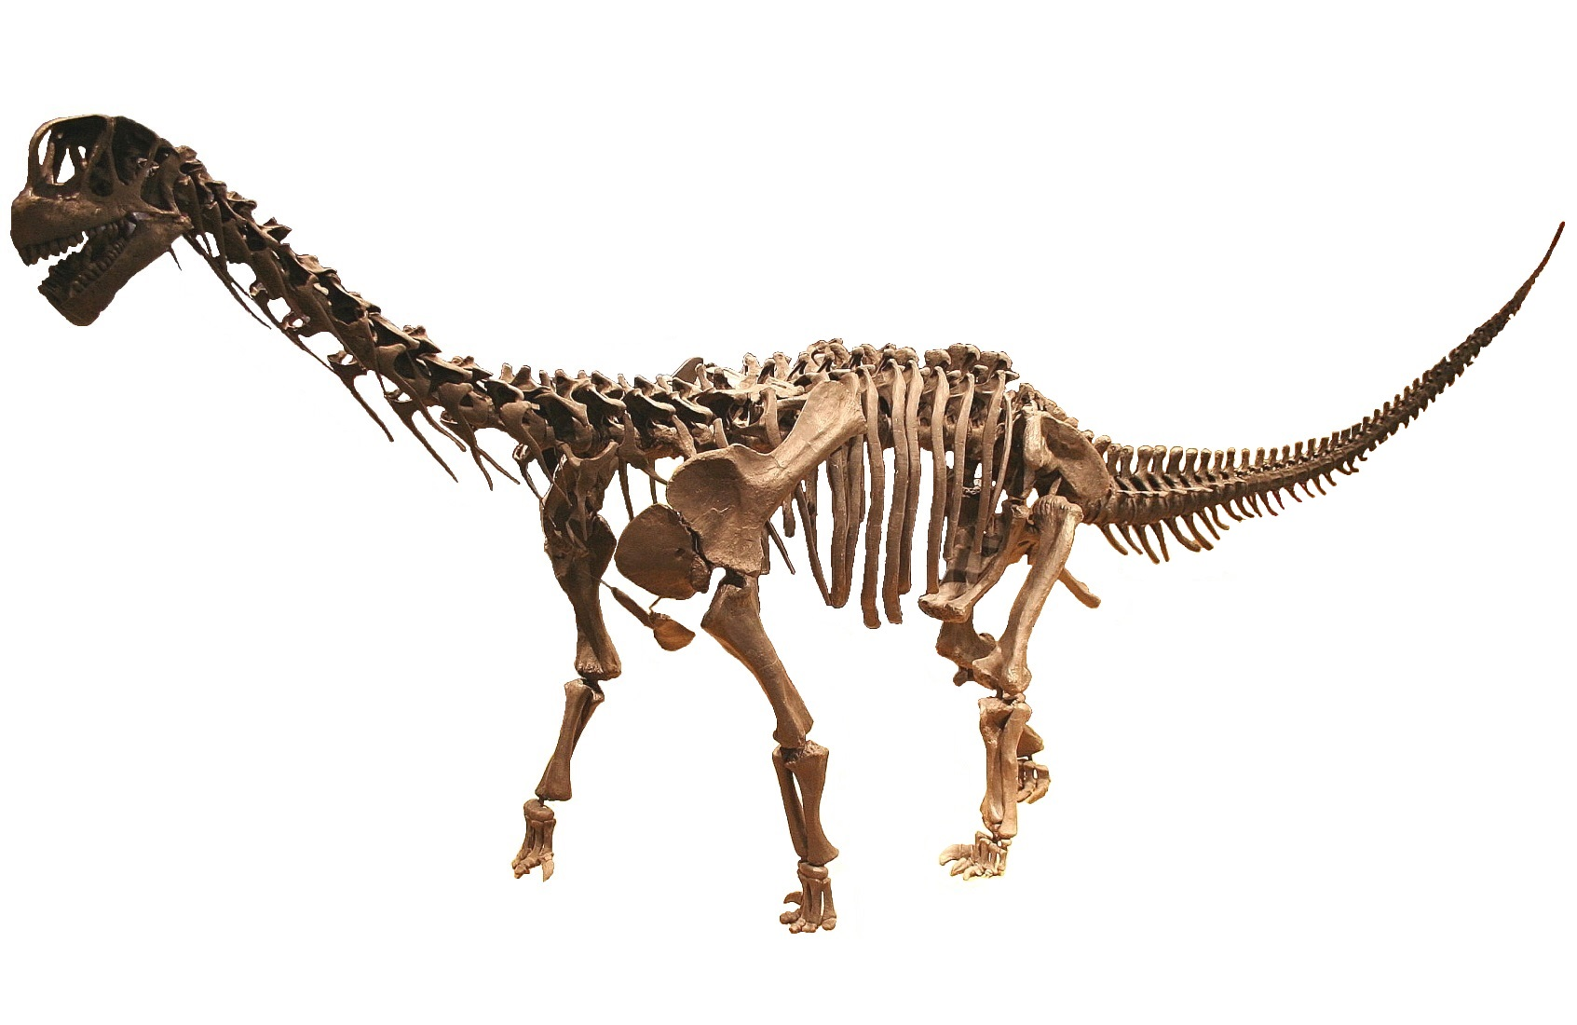
Supervised learning
Regression
What is the relationship between dinosaur height, length and weight? Can we predict weight for a new specimen of a given size?
Classification
Is there a relationship between a dinosaurs size and its (sub)order? Can we predict the the dinosaurs order given just measurement of its size?
Feature selection
Reduce the number of parameters in the dataset

Slide 5
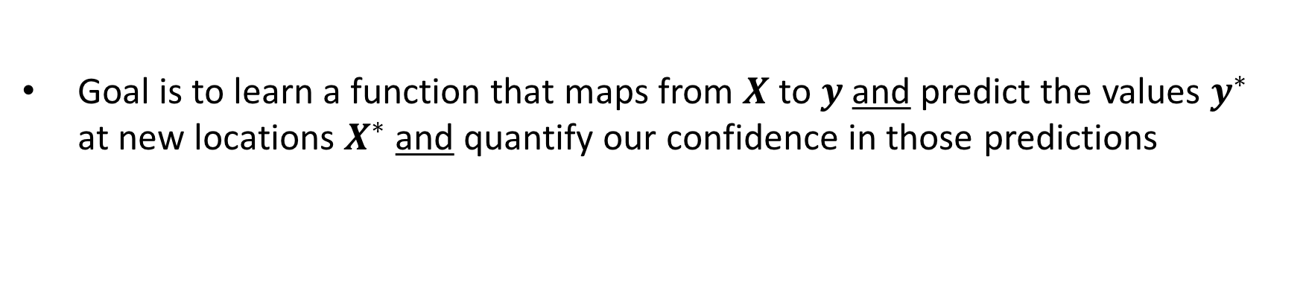
Supervised learning
Goal is to learn a function that maps from $X$ to $y$ and predict the values $y^{∗}$ at new locations $X^{∗}$ and quantify our confidence in those predictions

Slide 6
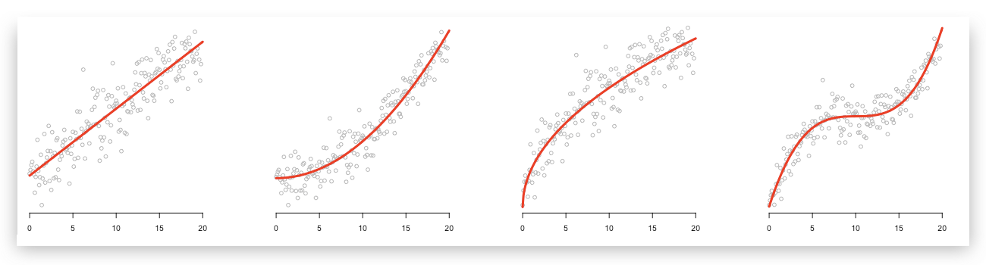
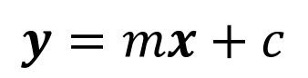
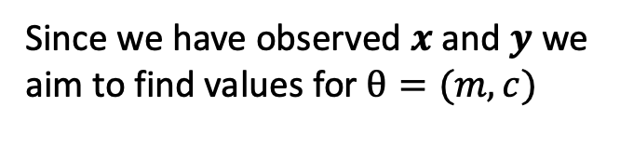
Linear regression
R PSEUDOCODE
$$y=mx+c$$
lrfit <- train(y~., data, method = "lm")
Since we have observed $x$ and $y$ we aim to find values for $θ=(m,c)$

Slide 7
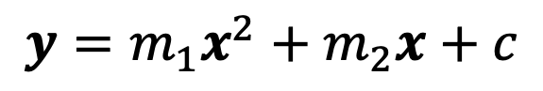
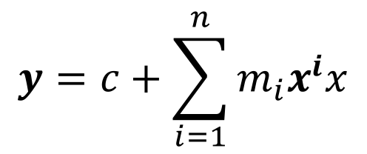
Polynomial regression
$$y=m_{1}x^{2}+m_{2}x+c$$
R PSEUDOCODE
lrfit <- train(y~poly(x,degree=2), data, method = "lm")
$$θ=(m_{1},…,m_{n},c)$$
$$y=c+\sum_{i=1}^{n}{m_{i}x^{i}x}$$

Slide 8
Polynomial regression
Set of (noisy) data

Slide 9
Polynomial regression
Set of (noisy) data
Can fit a polynomial

Slide 10
Polynomial regression
Set of (noisy) data
Can fit a polynomial
What about this polynomial?

Slide 11
Polynomial regression
Set of (noisy) data
Can fit a polynomial
What about this polynomial?
Higher order polynomial would pass closer to more data points

Slide 12
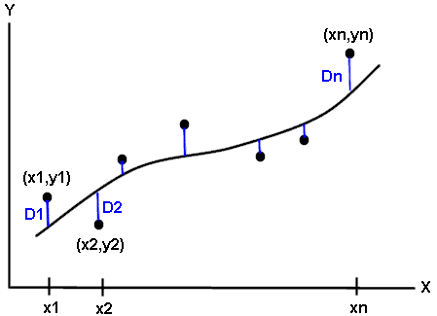

Polynomial regression
Split the data: training and test set
Want an objective way to measure if a model is truly learning about the system or simply interpolating through the data (noise)
Too simple a model won’t have the descriptive power to explain the observations (underfitting)
Too complex a model will be able to describe the training data very well, but won’t generalise to the test data (overfitting)

Slide 13
Polynomial regression

Slide 14
Are there other ways that don’t require us to split data?
Use the language of probability to quantify uncertainty

Slide 15
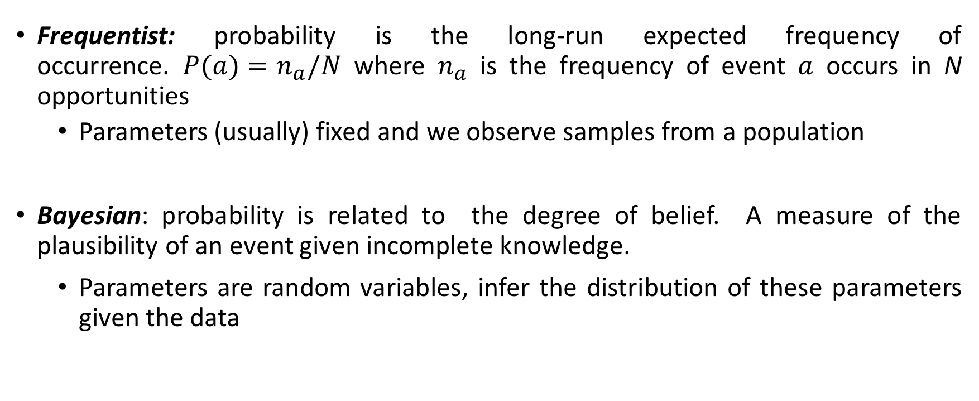
A primer on statistics
Frequentist: probability is the long-run expected frequency of occurrence. $P(a)=n_{a}/N$where $n_{a}$ is the frequency of event $a$ occurs in N opportunities
Parameters (usually) fixed and we observe samples from a population
Bayesian: probability is related to the degree of belief. A measure of the plausibility of an event given incomplete knowledge.
Parameters are random variables, infer the distribution of these parameters given the data

Slide 16
A primer on statistics
Let’s start by flipping a coin
What is the probability of seeing a head? p_{H}
We know this will have a value somewhere between 0 and 1
If the coin is unbiased we have p = 0.5

Slide 17
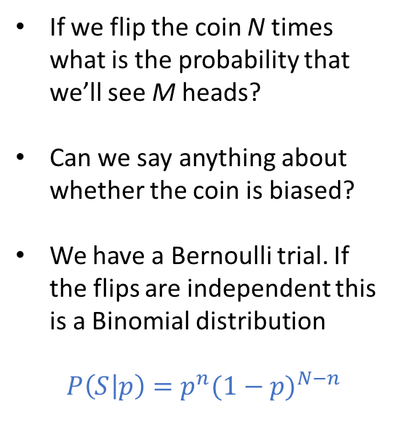
A primer on statistics
If we flip the coin N times what is the probability that we’ll see M heads?
Can we say anything about whether the coin is biased?
We have a Bernoulli trial. If the flips are independent this is a Binomial distribution
$P\left(S | p\right)=p^{n}{(1−p)}^{N−n}$
TT
HT
TH
HH

Slide 18
A primer on statistics
…
TTT
HTT
THT
TTH
HHT
HTH
THH
HHH

Slide 19
A primer on statistics
…

Slide 20
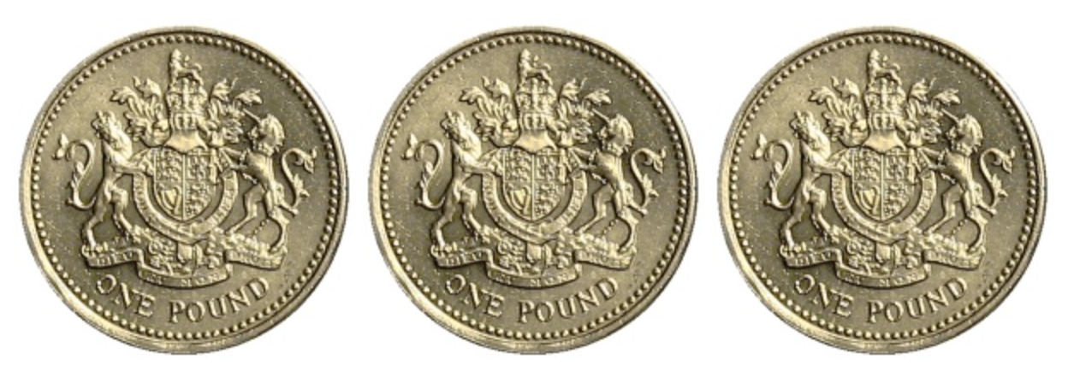
Null hypothesis: our coin is unbiased
Given that the null hypothesis is true what is the probability that the statistic summary you observe is greater than or equal to the value you observed?
We flip a coin N times and get M heads. What is the probability that we would observed >= M heads
Virtual coin flip: www.random.org/coins

Slide 21
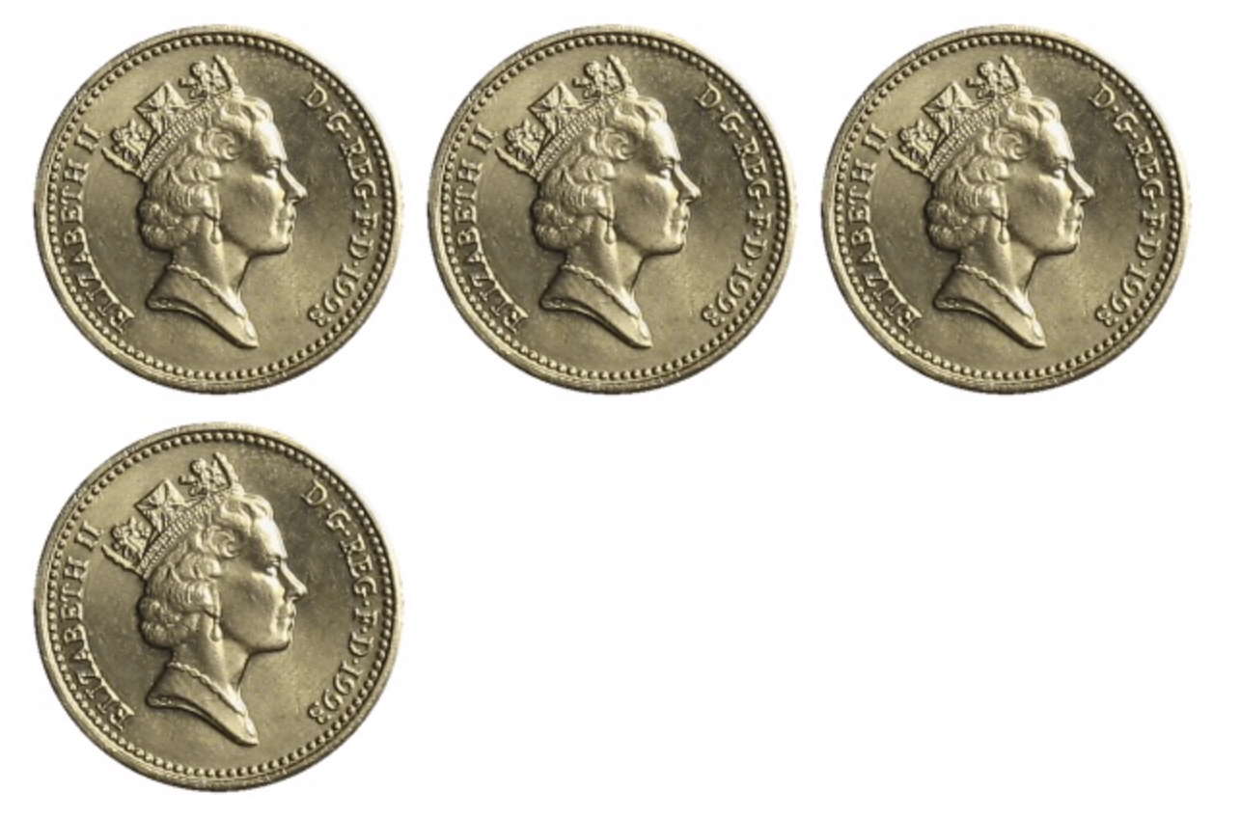
Virtual coin flip: www.random.org/coins

Slide 22
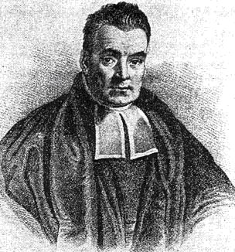
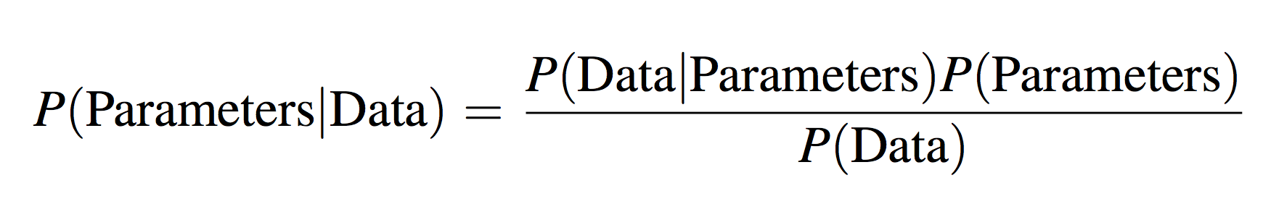
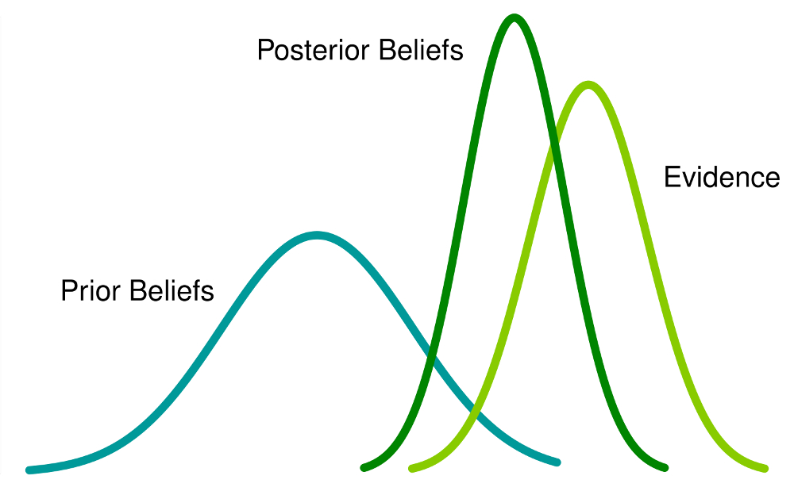
A primer on Bayesian inference
Notes:
Kristian Lum

Slide 23
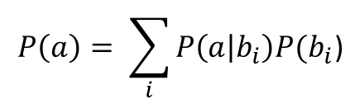
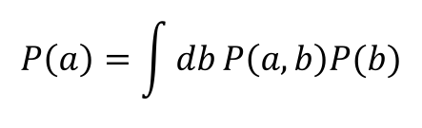
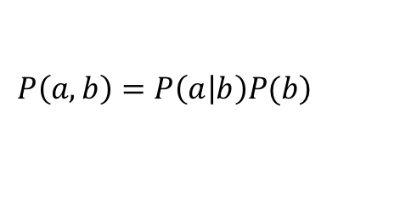
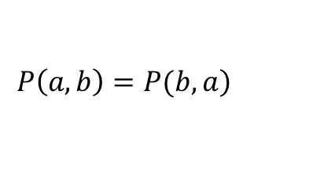
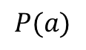
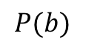
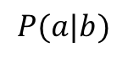
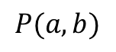



A primer on Bayesian inference
A few definitions:
$$P(a)$$
The probability that $a$ happens
$$P(b)$$
The probability that $b$ happens
Joint probability:
$$P(a,b)$$
The probability that $a$ and $b$ happens
Conditional probability:
$$P(a|b)$$
The probability that $a$ happens given an observed value for $b$
$$\left.P\left(a,b\right)=P\left(a | b\right)P(b\right)$$
Decompose joint distribution into condition
$$P\left(a\right)= \sum_{i}{P\left(a | b_{i}\right)P(b_{i}\text{)}}$$
$$P\left(a\right)=\int{db}P\left(a,b\right)P(b)$$
Marginalise:
$$\left.P\left(a,b\right)=P(b,a\right)$$

Slide 24
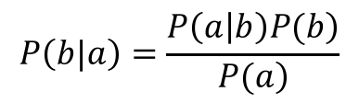
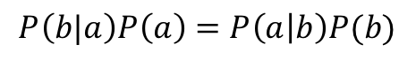
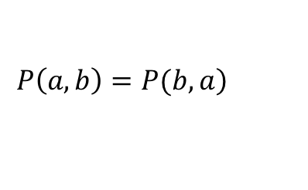
A primer on Bayesian inference
Probabilities are commutative:
$$\left.P\left(a,b\right)=P(b,a\right)$$
Putting them together for Bayes rule:
$$P\left(b|a\right)P\left(a\right)=P\left(a | b\right)P(b)$$
$$P\left(b|a\right)=\frac{\left.P\left(a | b\right)P(b\right)}{\left.P(a\right)}$$

Slide 25
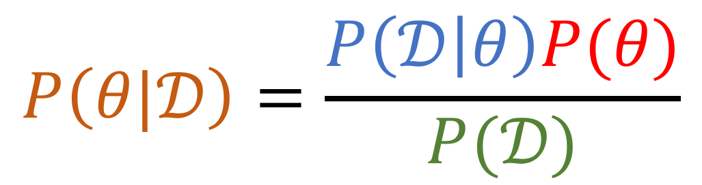
A primer on Bayesian inference
Posterior distribution
Likelihood
Prior distribution
$$P\left(θ|𝒟\right)=\frac{P\left(𝒟 | θ\right)P(θ)}{P(𝒟)}$$
Marginal likelihood or “evidence”
Or … if to make an observation that diverges largely from all current knowledge you need a lot of evidence

Slide 26
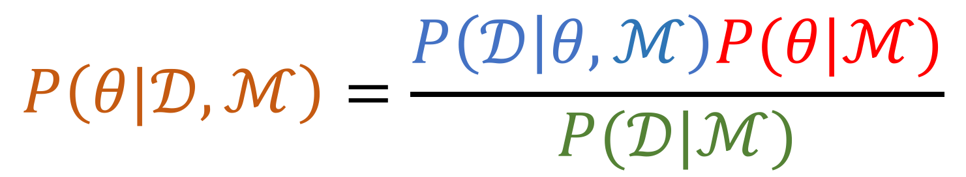
A primer on Bayesian inference
Posterior distribution
Likelihood
Prior distribution
$$P\left(θ|𝒟,ℳ\right)=\frac{P\left(𝒟 | θ,ℳ\right)P(θ|ℳ)}{P(𝒟|ℳ)}$$
Marginal likelihood or “evidence”
Or … if to make an observation that diverges largely from all current knowledge you need a lot of evidence

Slide 27
A primer on Bayesian inference
What you now believe about the system
What your data is saying
What’s already known about the system
Posterior distribution
Likelihood
Prior distribution
$$P\left(θ|𝒟,ℳ\right)=\frac{P\left(𝒟 | θ,ℳ\right)P(θ|ℳ)}{P(𝒟|ℳ)}$$
Marginal likelihood or “evidence”
Given your model how likely were you to have generated the observations you did
Or … if to make an observation that diverges largely from all current knowledge you need a lot of evidence

Slide 28
Doing Bayesian inference
Virtual coin flip: www.random.org/coins

Slide 29
Doing Bayesian inference
What is the likelihood of observing this sequence of events?
Are the flips independent? Binomial distribution.
Is the coin biased? Can we say anything about the probability, p, of seeing a head next time?
What is the uncertainty in p?

Slide 30

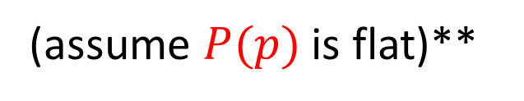
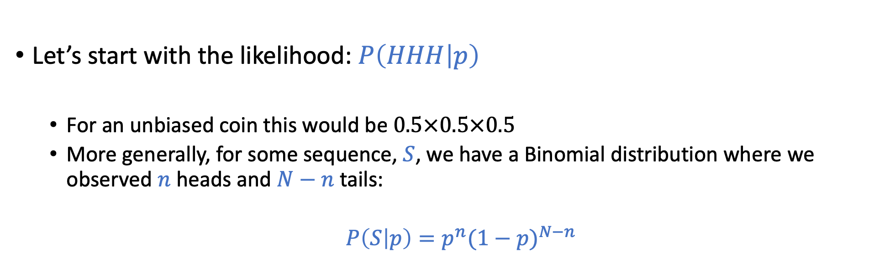
Doing Bayesian inference
$$P\left(p|HHH\right)=\frac{P\left(HHH | p\right)P(p)}{P(𝒟)}$$
Apply Bayes’ rule:
Let’s start with the likelihood: $P\left(HHH | p\right)$
For an unbiased coin this would be $0.5×0.5×0.5$
More generally, for some sequence, $S$, we have a Binomial distribution where we observed $n$ heads and $N−n$ tails:
$P\left(S | p\right)=p^{n}{(1−p)}^{N−n}$
(assume $P(p)$ is flat)**

Slide 31
Doing Bayesian inference
Apply Bayes’ rule:
$$P\left(p|HHH\right)∝P\left(HHH | p\right)P(p)$$
Let’s start with the likelihood: $P\left(HHH | p\right)$
For an unbiased coin this would be $0.5×0.5×0.5$
More generally, for some sequence, $S$, we have a Binomial distribution where we observed $n$ heads and $N−n$ tails:
$P\left(S | p\right)=p^{n}{(1−p)}^{N−n}$
(assume $P(p)$ is flat)**

Slide 32
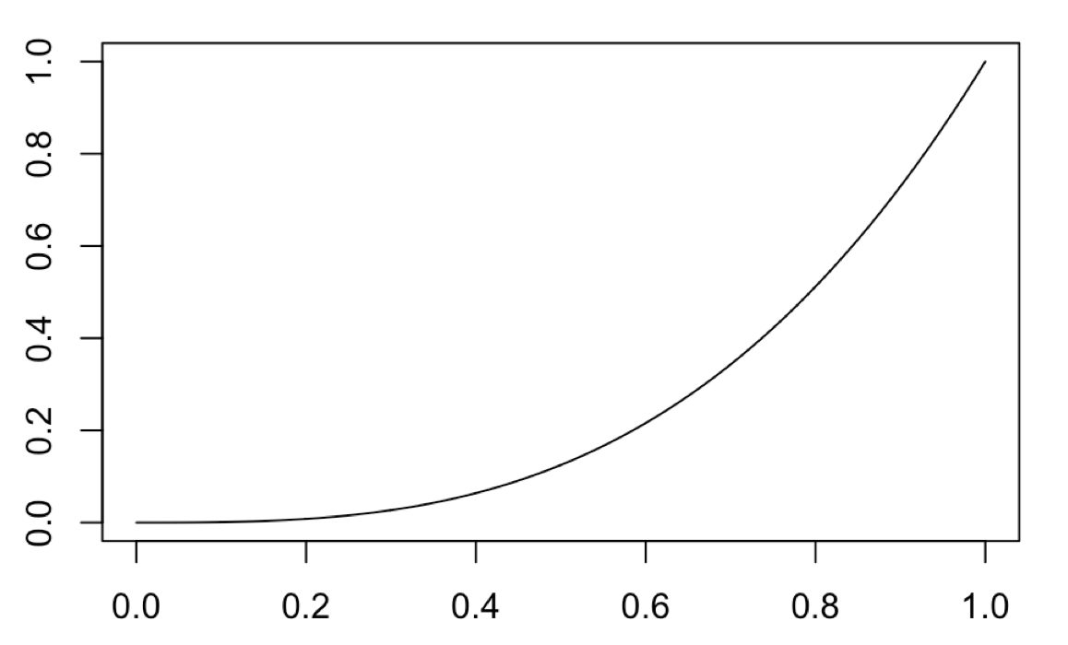
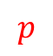

Doing Bayesian inference
coinflip <- function(p, N, n){
P <- p^n * (1-p)^(N-n) * 1
return(P)
}
L=lapply(seq(0,1,0.001),coinflip, 3, 3)
plot(seq(0,1,0.001),unlist(L),type="l")
$$P(p)$$
$$p$$

Slide 33
Doing Bayesian inference
coinflip <- function(p, N, n){
P <- p^n * (1-p)^(N-n) * 1
return(P)
}
L=lapply(seq(0,1,0.001),coinflip, 3, 3)
plot(seq(0,1,0.001),unlist(L),type="l")
$$P(p)$$
$$p$$
Most likely parameter value: Maximum likelihood or maximum a posteriori (MAP)

Slide 34
Doing Bayesian inference
coinflip <- function(p, N, n){
P <- p^n * (1-p)^(N-n) * 1
return(P)
}
L=lapply(seq(0,1,0.001),coinflip, 3, 3)
plot(seq(0,1,0.001),unlist(L),type="l")
$$P(p)$$
$$p$$
But we have a distribution: what are the 95% confidence intervals

Slide 35

Doing Bayesian inference
Okay we’ve been a little bit naughty with our prior distribution
Bayes’ rule:
$$P\left(p|HHH\right)∝P\left(HHH | p\right)P(p)$$
Okay, now let’s try setting doing something sensible with $P(p)$

Slide 36
Doing Bayesian inference
Need to think of how we set our prior belief.

Slide 37
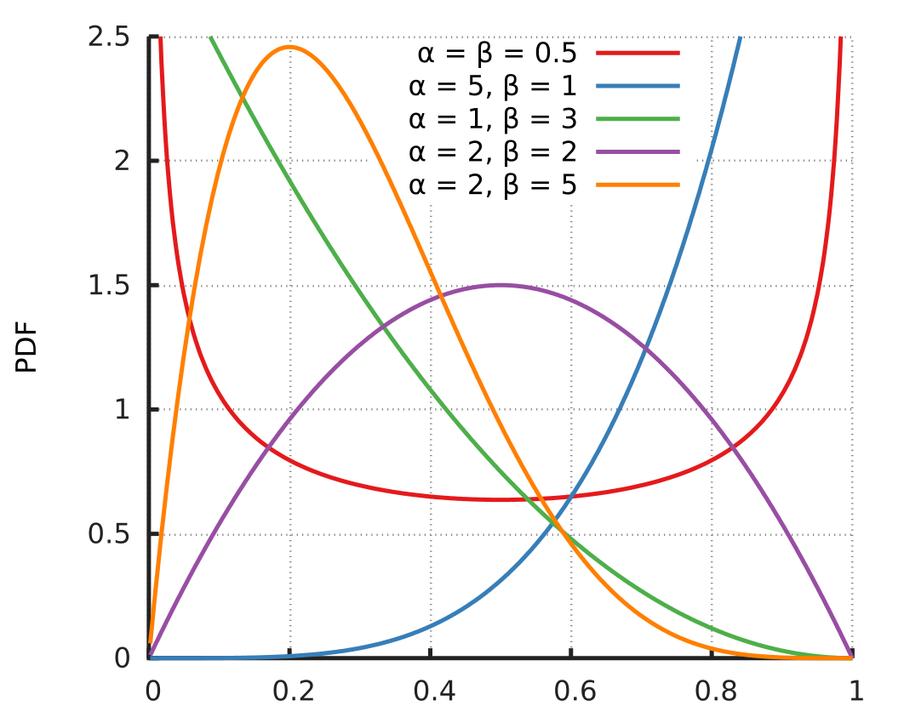
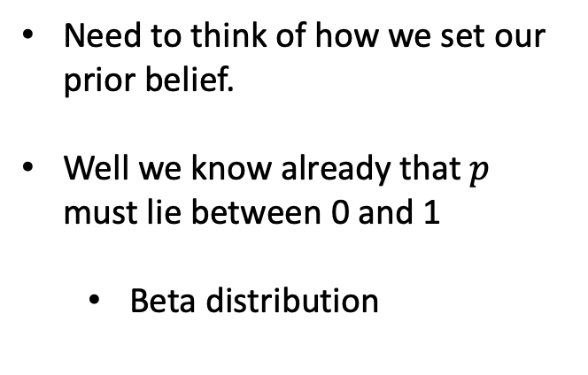
Doing Bayesian inference
Need to think of how we set our prior belief.
Well we know already that $p$ must lie between 0 and 1
Beta distribution

Slide 38
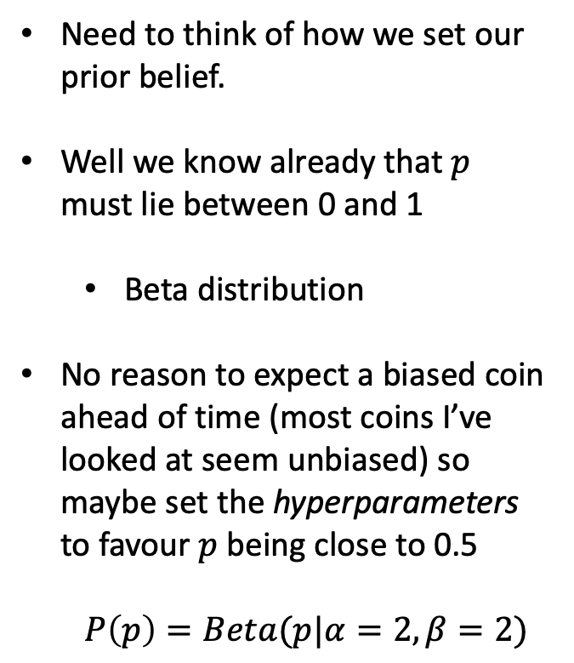
Doing Bayesian inference
Need to think of how we set our prior belief.
Well we know already that $p$ must lie between 0 and 1
Beta distribution
No reason to expect a biased coin ahead of time (most coins I’ve looked at seem unbiased) so maybe set the hyperparameters to favour $p$ being close to 0.5
$$P\left(p\right)=Beta(p|α=2,β=2)$$

Slide 39
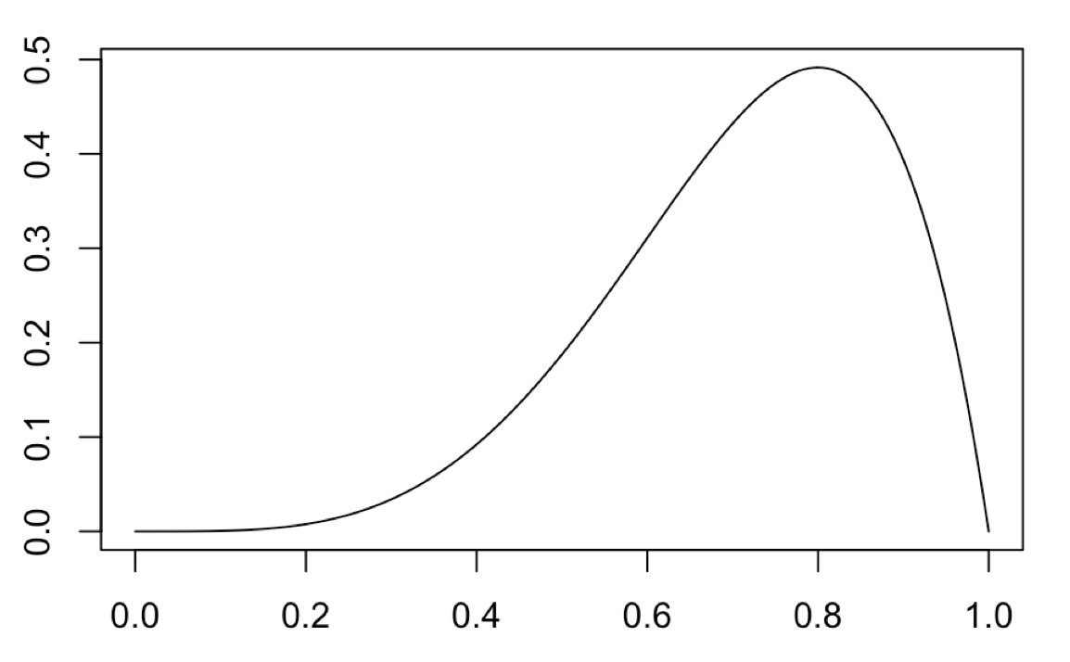
Doing Bayesian inference
coinflip <- function(p, N, n){
P <- p^n * (1-p)^(N-n) *
dbeta(p, 2, 2, ncp = 0, log = FALSE)
return(P)
}
L=lapply(seq(0,1,0.001),coinflip, 3, 3)
plot(seq(0,1,0.001),unlist(L),type="l")

Slide 40
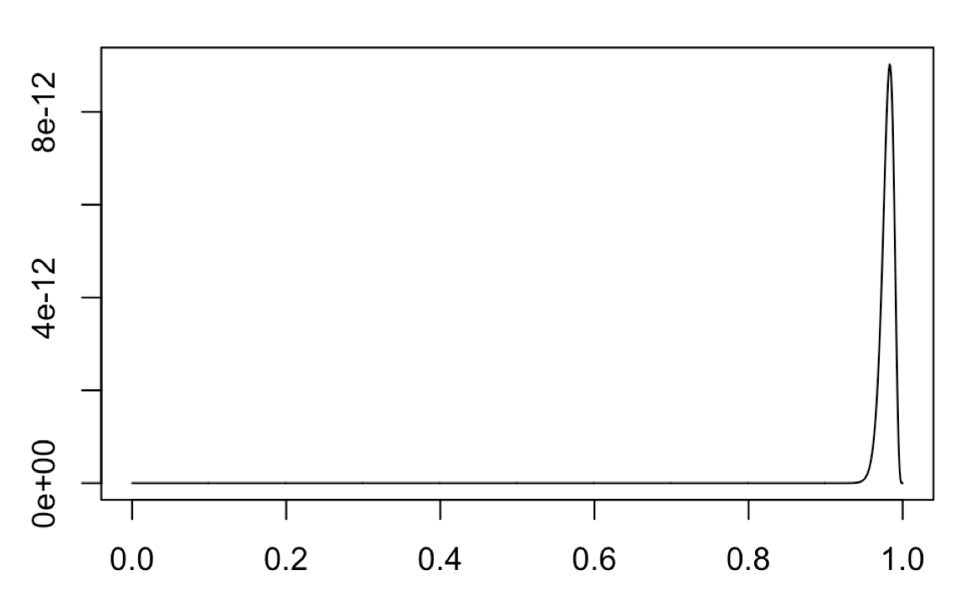
Doing Bayesian inference
Seems a little like we’re telling it the answer before hand!
What happens when we have many observations from a biased coin?
295 heads from 300 observations
Keep the same prior (no bias)
If you make exceptional claims you should have exceptional evidence

Slide 41
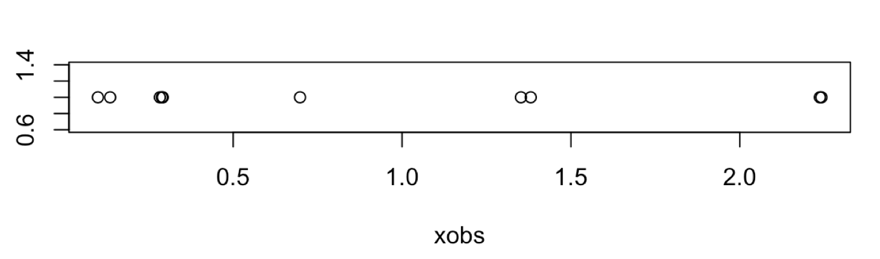
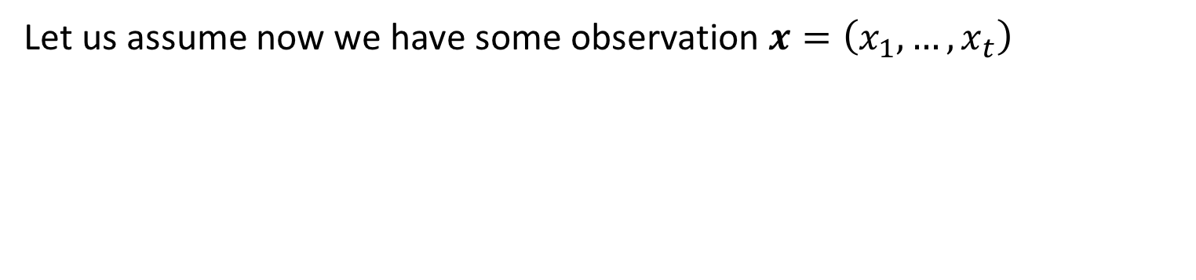
Doing Bayesian inference
Let us assume now we have some observation $x=\left(x_{1},…,x_{t}\right)$
How do we model this?
.

Slide 42
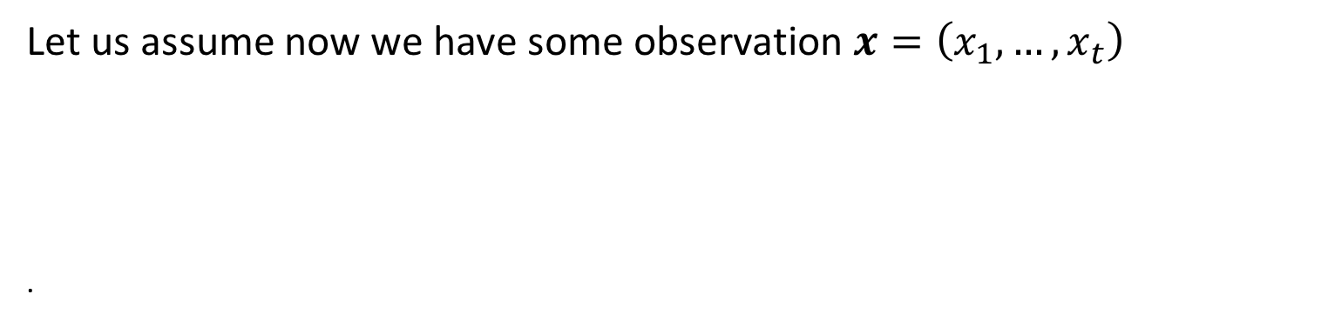
Doing Bayesian inference
Let us assume now we have some observation $x=\left(x_{1},…,x_{t}\right)$
.
How do we model this? Looks continuous …
.

Slide 43
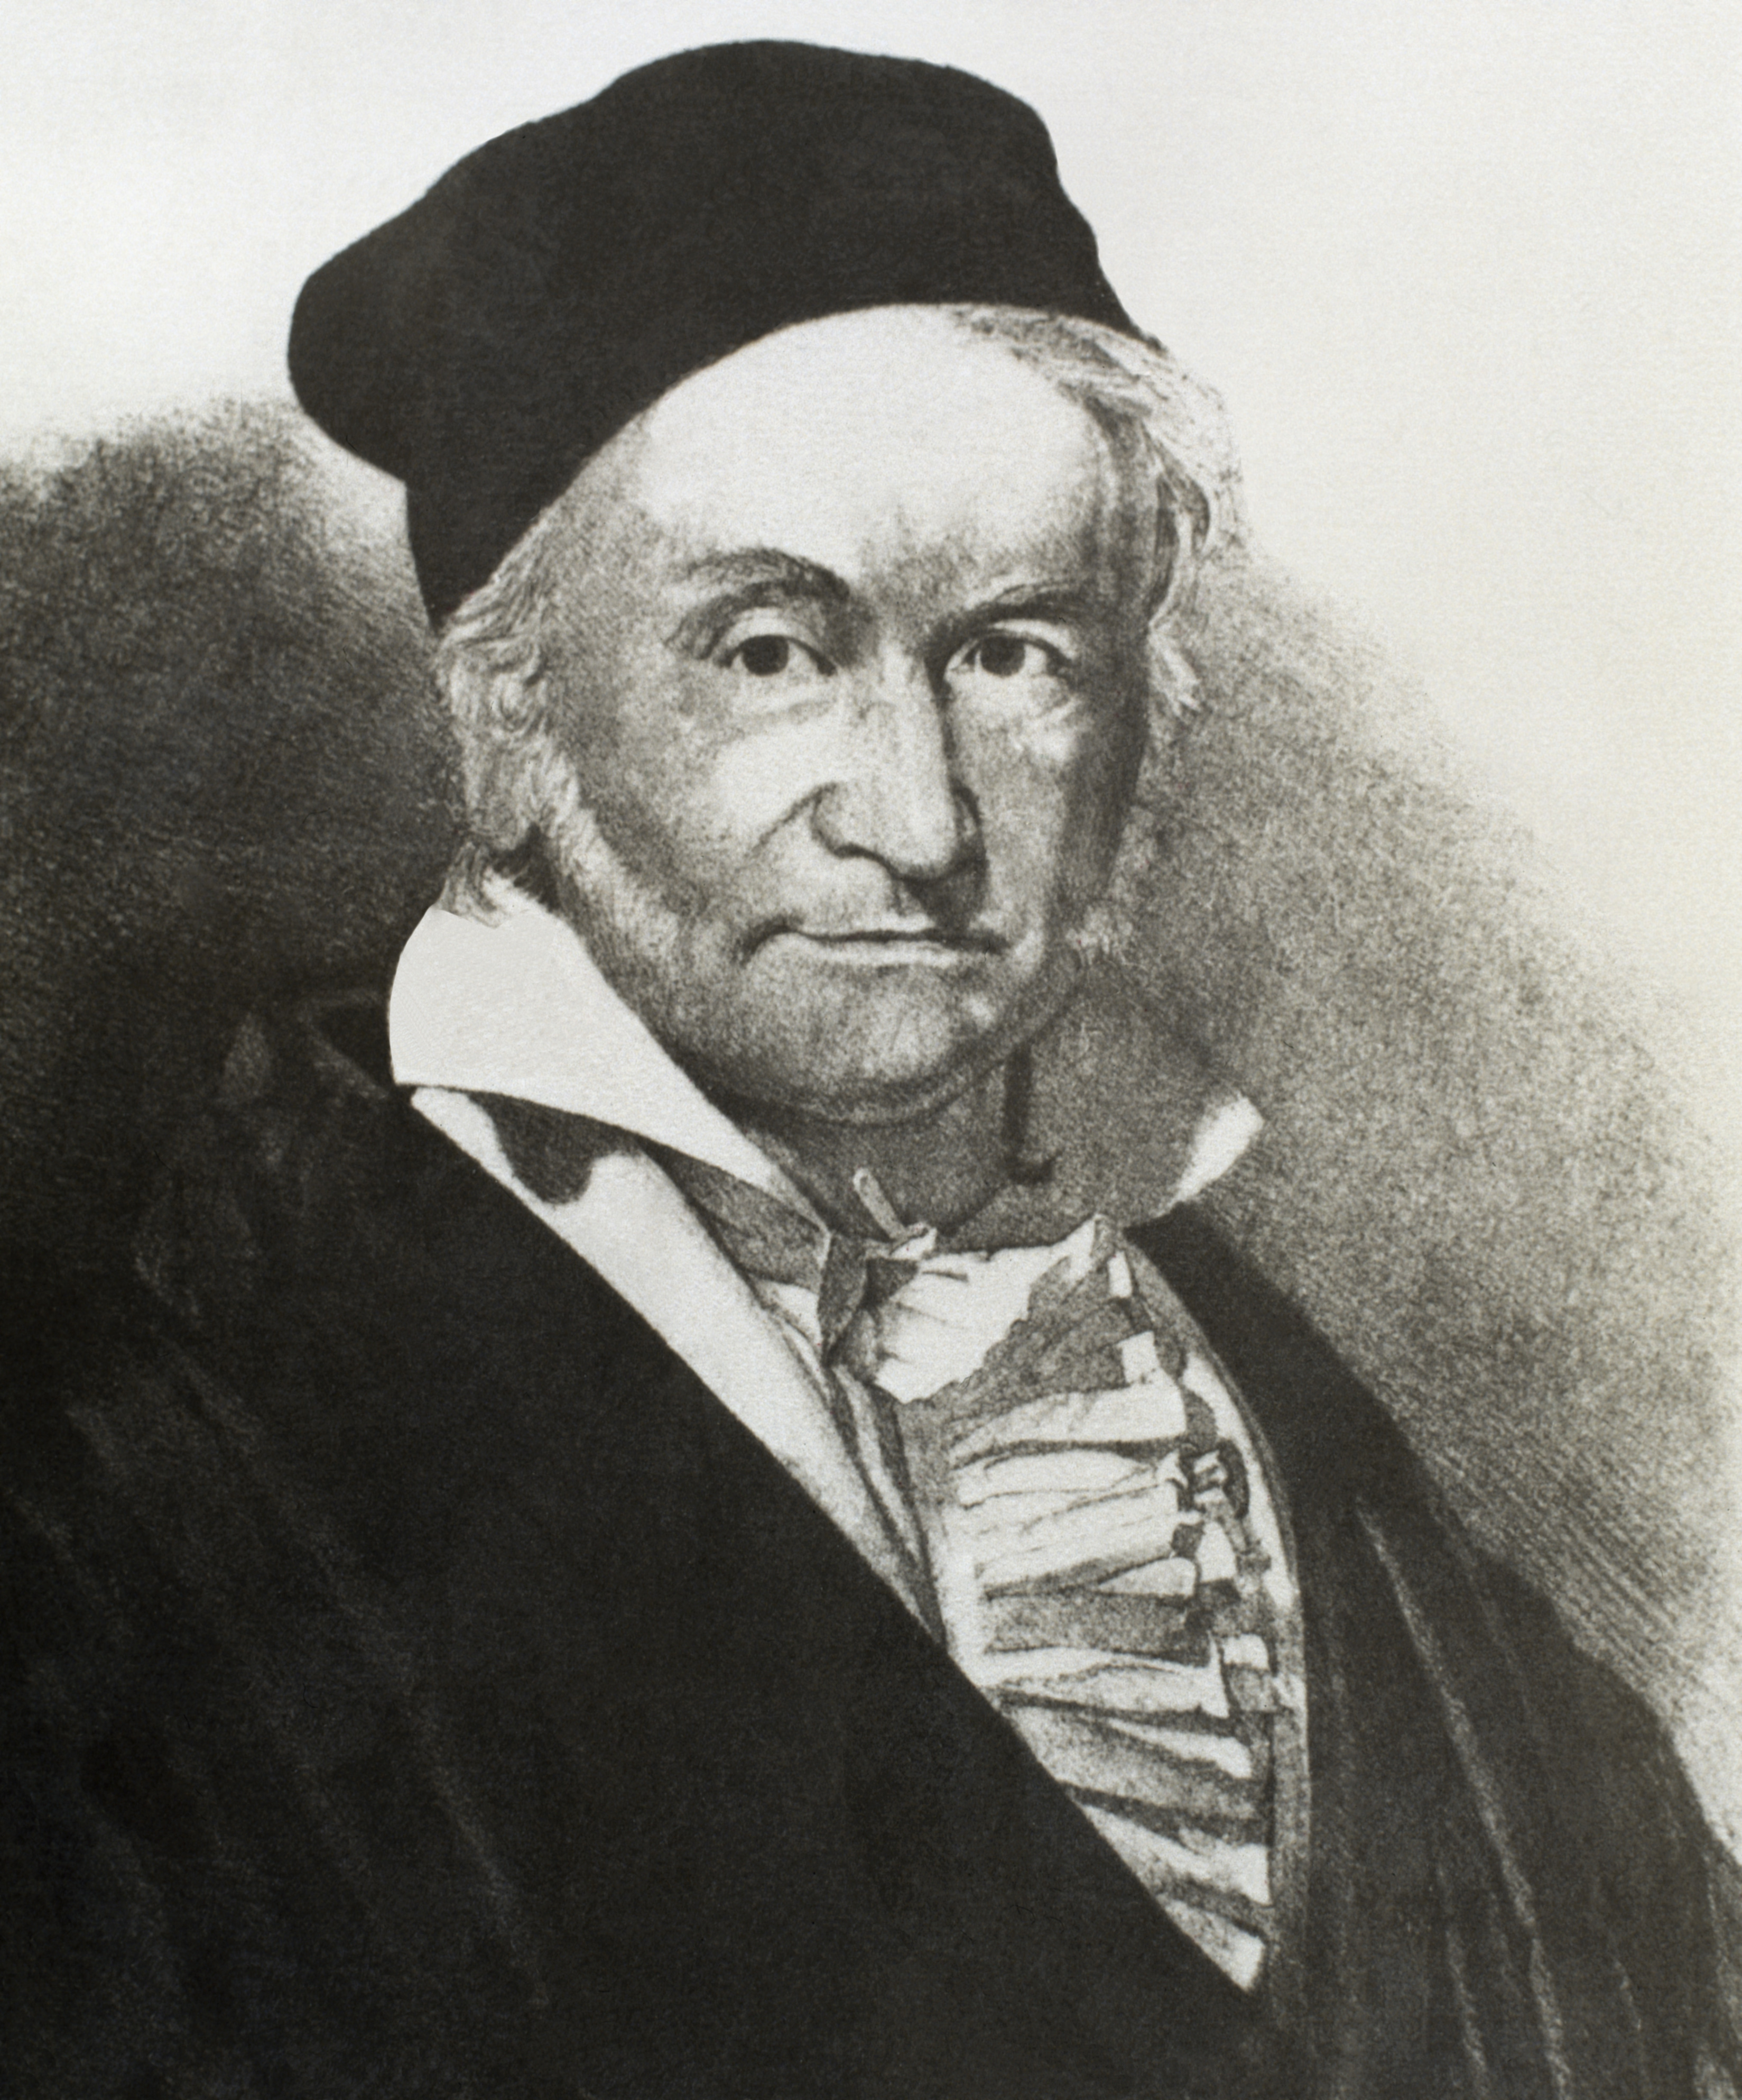
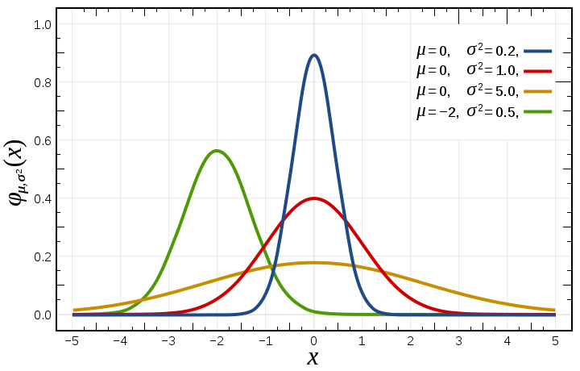
Doing Bayesian inference

Slide 44
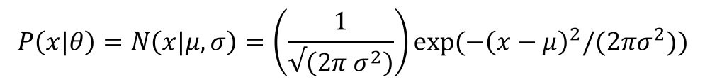
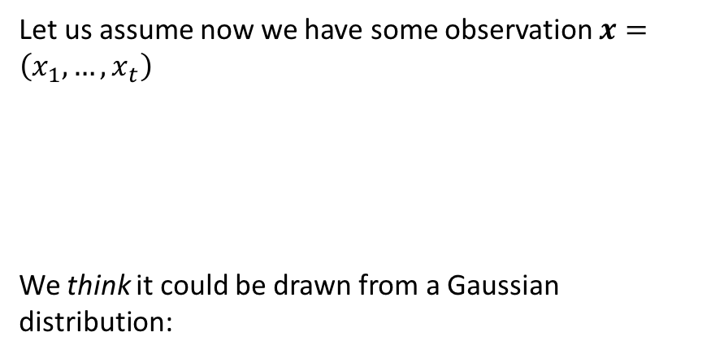

Doing Bayesian inference
Let us assume now we have some observation $x=\left(x_{1},…,x_{t}\right)$
We think it could be drawn from a Gaussian distribution:
$$P\left(x|θ\right)=N\left(x|μ,σ\right)=\left(\frac{1}{√\left(2π σ^{2}\right)}\right)exp⁡({−\left(x−μ\right)}^{2}/(2πσ^{2}))$$
Likelihood:
$$P\left(x|θ\right)=\prod{P\left(x_{i}|θ\right)}$$

Slide 45
Doing Bayesian inference
Let us assume now we have some observation $x=\left(x_{1},…,x_{t}\right)$
We think it could be drawn from a Gaussian distribution:
gaussiandist <- function(x, mu, sigma){
L <- prod((1/(sqrt(2*pi*sigma^2))) * exp(-(x-mu)^2 / (2*sigma^2)))
return(L)
}
mu = seq(-5,5,0.001)
sigma = seq(0.001,1.5,0.001)
L<-matrix(0,length(mu),length(sigma))
for (i in 1:length(mu)) {
for (j in 1:length(sigma)) {
L[i,j]<-gaussiandist(xobs,mu[i],sigma[j]) }
}
$$P\left(x|θ\right)=N\left(x|μ,σ\right)=\left(\frac{1}{√\left(2π σ^{2}\right)}\right)exp⁡({−\left(x−μ\right)}^{2}/(2πσ^{2}))$$
Likelihood:
$$P\left(x|θ\right)=\prod{P\left(x_{i}|θ\right)}$$

Slide 46

Doing Bayesian inference
gaussiandist <- function(x, mu, sigma){
L <- prod((1/(sqrt(2*pi*sigma^2))) * exp(-(x-mu)^2 / (2*sigma^2)))
return(L)
}
mu = seq(-5,5,0.001)
sigma = seq(0.001,1.5,0.001)
L<-matrix(0,length(mu),length(sigma))
for (i in 1:length(mu)) {
for (j in 1:length(sigma)) {
L[i,j]<-gaussiandist(xobs,mu[i],sigma[j]) }
}

Slide 47
Doing Bayesian inference
Actually … a friend of mine just took a look at the data and said whoever told me it was Gaussian is talking rubbish.

Slide 48

Doing Bayesian inference

Slide 49



$$P\left(θ|𝒟,ℳ\right)=\frac{P\left(𝒟 | θ,ℳ\right)P(θ|ℳ)}{P(𝒟|ℳ)}$$
Doing Bayesian inference
Okay, let’s try a different model. Let us assume a gamma distribution:
$$P\left(x|θ\right)=\prod{G\left(x|k,θ\right)}=\prod{\left(\frac{1}{Γ\left(k\right)θ^{k}}\right)x^{k−1}exp⁡(−x/θ)}$$
gammadist <- function(x, k, theta){
L <- prod((1/(gamma(k)*theta^k))x^(k-1)*exp(-x/theta))
return(L)
}

Slide 50


Doing Bayesian inference
$$P\left(θ|𝒟,ℳ\right)=\frac{P\left(𝒟 | θ,ℳ\right)P(θ|ℳ)}{P(𝒟|ℳ)}$$
$$P\left(𝒟 | ℳ\right)=\int{dθ}P\left(𝒟 | θ,ℳ\right)P(θ|ℳ)$$

Slide 51





Doing Bayesian inference
$$P(𝒟|ℳ_{1})$$
$$P(𝒟|ℳ_{2})$$
$$\int{dθ}P\left(𝒟 | θ,ℳ\right)P(θ|ℳ)$$
I1<-matrix(0,length(mu),1
for (i in 1:length(mu)) {
I1[i,1]<-trapz(sigma,L1[i,])
}
intGauss<-trapz(mu,I1)
I2<-matrix(0,length(k),1)
for (i in 1:length(k)) {
I2[i,1]<-trapz(theta,L[i,])
}
intGamma<-trapz(k,I2)
$$\int{dθ}P\left(𝒟 | θ,ℳ_{1}\right)P\left(θ | ℳ_{1}\right)=\text{2.166697}\text{e}\text{−06}$$
$$\int{dθ}P\left(𝒟 | θ,ℳ_{2}\right)P\left(θ | ℳ_{2}\right)=\text{7.583745}\text{e}\text{−05}$$
Notes:
xobs <- rgamma(10, shape=1, rate = 1)

Slide 52
Doing Bayesian inference
$$P(𝒟|ℳ_{1})$$
$$P(𝒟|ℳ_{2})$$
$$\int{dθ}P\left(𝒟 | θ,ℳ\right)P(θ|ℳ)$$
I1<-matrix(0,length(mu),1
for (i in 1:length(mu)) {
I1[i,1]<-trapz(sigma,L1[i,])
}
intGauss<-trapz(mu,I1)
I2<-matrix(0,length(k),1)
for (i in 1:length(k)) {
I2[i,1]<-trapz(theta,L[i,])
}
intGamma<-trapz(k,I2)
$$\int{dθ}P\left(𝒟 | θ,ℳ_{1}\right)P\left(θ | ℳ_{1}\right)=\text{2.166697}\text{e}\text{−06}$$
$$\int{dθ}P\left(𝒟 | θ,ℳ_{2}\right)P\left(θ | ℳ_{2}\right)=\text{7.583745}\text{e}\text{−05}$$
xobs <- rgamma(10, shape=1, rate = 1)
Notes:
xobs <- rgamma(10, shape=1, rate = 1)

Slide 53


So what?
Can we do regression in a probabilistic (Bayesian) way?
$$y=mx+c$$
$$y=m_{1}x^{2}+m_{2}x+c$$

Slide 54

(Bayesian) polynomial regression
R PSEUDOCODE
lmfit <- lm(y~poly(x,degree=2), data)
simulate <- coef(sim(lmfit))
paramsamp <- head(simulate,10)

Slide 55

Gaussian process regression
$$y=f(x)+noise$$
$$P\left(f|y\right)∝P\left(y | f\right)P\left(f\right)$$

Slide 56


Slide 57
I like these.
Any way to put them together?

Slide 58
I like these.
Any way to put them together?
Gaussian process regression

Slide 59

Tasks
Use linear and nonlinear regression to analyse Arabidopsis thaliana gene expression time series data following inoculation with the necrotrophic fungus Botrytis cinereal
(optional) Use marginal likelihood to distinguish different models

Slide 60
Hyperparameters
Use marginal likelihood to select optimal hyperparameters:
Grid search
Gradient optimisation

Slide 61
Classification

Slide 62
Classification
Supervised learning
Usually a tuple of observations (X,y)
Output y is a discrete (categorical) output e.g., binary y_{i} ∈ [0,1]
Some algorithms require us to represent y in one-hot encoding
y = (1,1,3,0,2,1)ᵀ
[0,1,0,0;
0,1,0,0;
0,0,0,1;
1,0,0,0;
0,0,1,0;
0,1,0,0]
one-hot
?
Goal is to identify function (mapping) from X to y
Identify a decision boundary

Slide 63

Classification
As before split the data into a training set and validation set
Class imbalance in classification

Slide 64

Evaluating performance: Receiver operating characteristics
Confusion matrix:
True positive: Predict y = 1, observation y = 1.
True negative: Predict y = 0, obs. y = 0.
False positive: Predict y = 1, obs. y = 0.
False negative: Predict y = 0, obs. y = 1.
Plot false positive rate (FPR) versus true positive rate (TPR):
TPR = TP/(TP+FN)
FPR = FP/(FP+TN)
Area under the curve (AUC)

Slide 65

Evaluating performance: Precision recall curve
Confusion matrix:
True positive: Predict y = 1, observation y = 1.
True negative: Predict y = 0, obs. y = 0.
False positive: Predict y = 1, obs. y = 0.
False negative: Predict y = 0, obs. y = 1.
Plot precision recall curves:
precision = TP/(TP+FP)
recall = TP/(TP+FN)
Area under the precision-recall curve (PR)

Slide 66

Logistic regression
Binary valued outputs, y, so linear regression is no good!

Slide 67




Logistic regression
Model probability of success
Solve for x
R PSEUDOCODE
lrfit <- train(y ~ ., data, method="glm", family="binomial")
Likelihood

Slide 68

GP classification
R PSEUDOCODE
gpcfit <- train(y~., data, method="gaussprPoly")

Slide 69
Classification
Logistic regression
Gaussian process classification
Support Vector Machine (SVM)
Random forests
Neural networks
Ensemble approaches
CODE
mod <- train(y ~ ., method = "glm", family = "Binomial")
mod <- train(y ~ ., method = ”gaussprPoly")
mod <- train(y ~ ., method = "svmRadial")
mod <- train(y ~ ., method = "mxnet")

Slide 70
Tasks
Use logistic regression and GP classification to look for marker genes that are indicative of infection status

Slide 71

$$y=f(x)+noise$$

